Slide 1
Inception Deck

Slide 2
Objectives
At the end of this lecture, you will
Learn how to create the Inception Deck

Slide 3

Inception Deck

Slide 4

Why?
Most projects failed before they even start
Reasons:
Failed to ask the right questions
Don’t have the courage to ask the tough questions

Slide 5
Project-related Questions
Who will use this?
Who will pay for this?
Is it safe to use?
How much experience does your team have?
Have you ever done this type of work before?
How much money do we have?
Who’s calling the shots on this project?
Do you see any challengers with having X analyst and Y developer?
Ask all scary questions up-front

Slide 6
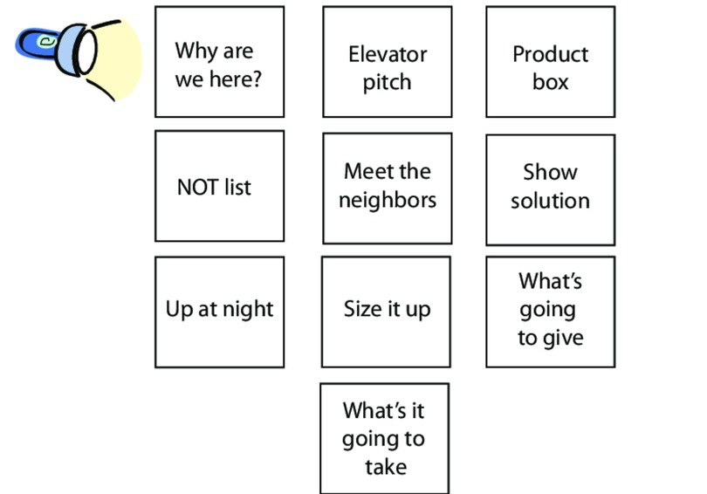
Inception Deck – In a Nutshell

Slide 7
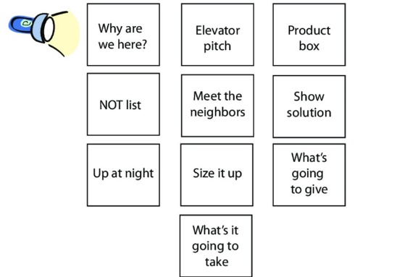
1. Ask why we are here
Write a 1-line description of your project mission.
The project mission helps you make decisions about what to do and why you are doing this

Slide 8
Whose Project Mission is this??
“To inspire and nurture the human spirit - one person, one cup, and one neighborhood at a time.”
Starbucks
“To be our customers' favorite place and way to eat and drink”
McDonald’s
“To organize the world's information and make it universally accessible and useful.”
Google
“To give people the power to build community and bring the world closer together”
Facebook
“To make it easy to do business anywhere.”
Alibaba
“To be earth's most customer-centric company; to build a place where people can come to find and discover anything they might want to buy online.”
Amazon
“Our mission is to develop students who are confident, self-directed, innovative and adaptable – equipped for success in the future economy”
Ngee Ann Polytechnic

Slide 9
2. Create an elevator pitch
Create an elevator pitch that helps you quickly explain the project to someone else.

Slide 10
2. Create an elevator pitch
Sample
For [learner/user/customer, e.g., Design for America members]
who [need, e.g., want to learn how to teach their teams to make better progress toward their goals]
the [product name, e.g., leadership guide]
is a [product type, e.g., online tutorial]
that [features or benefits, e.g., teaches leads how to facilitate meetings that identify and eliminate project obstacles].
Unlike [existing solution or competitors, e.g., existing human-centered design curriculum]
our product [novelty or competitive advantage, e.g., teaches easy to use project management that can be integrated into the design process].

Slide 11
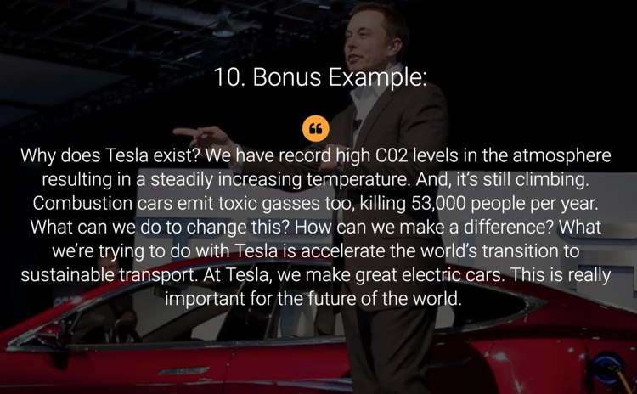
Example – Elevator Pitch - Tesla
Source: Bennett, S (2018), “Elevator pitch examples from successful startups”, https://slidebean.com/blog/startups/elevator-pitch-examples

Slide 12
3. Design a product box
Imagine that you are going to sell your learning environment in a box that sits on a store shelf. Create the box for it by describing:
Top 3 benefits; note that if you find yourself listing features, make sure to convert them to benefits.
A catchy slogan
The product name & picture

Slide 13
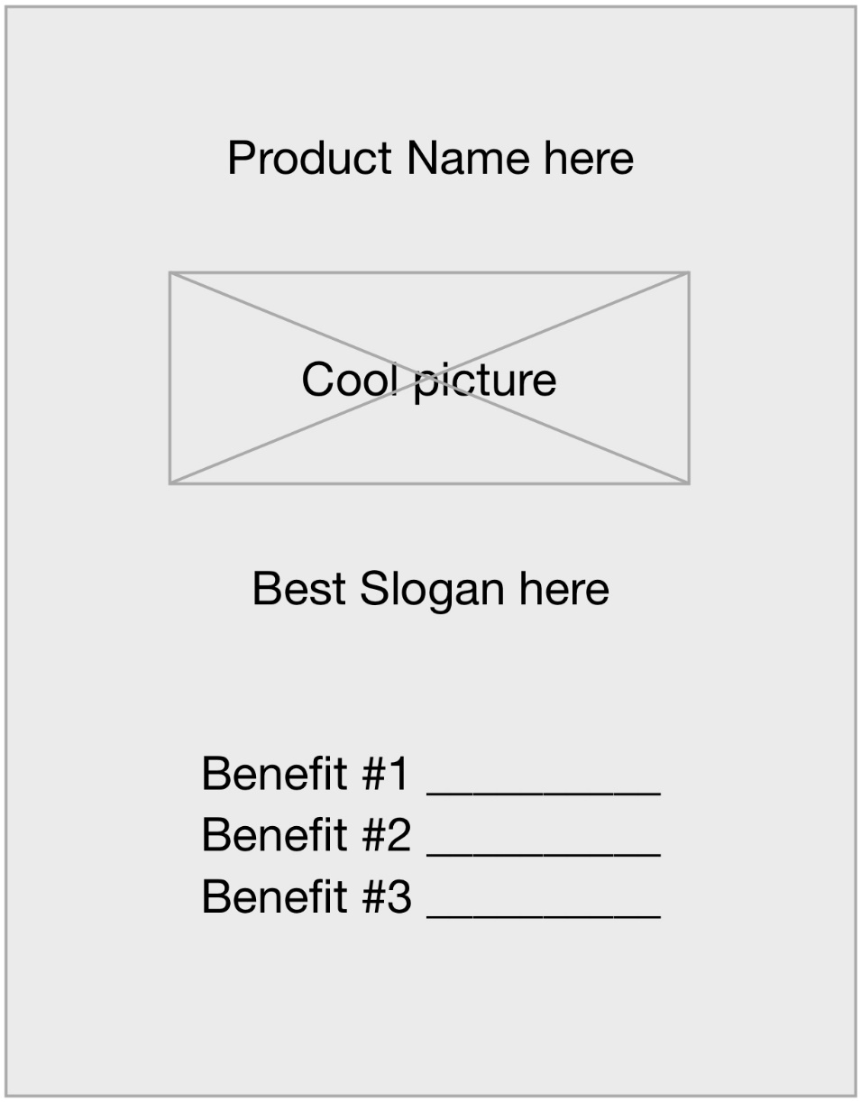
Template - Product Box

Slide 14
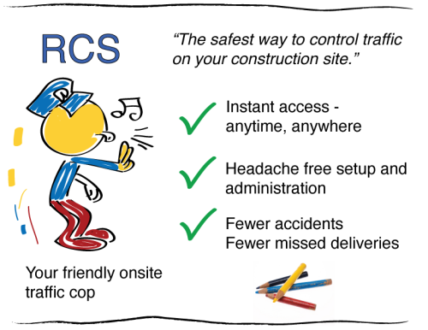
Example - Product Box

Slide 15
4. Create a NOT list
Write a list of what is:
In scope (“must have”)
Out of scope (“nice to have”)
Unresolved (“not sure??”)
The Not-List helps you avoid getting into a project that is too big to complete.

Slide 16
Template - NOT List
IN Scope | OUT of Scope
UNRESOLVED

Slide 17
15 Questions You Should Ask Every Time You Start A Project
What are the objectives? How do you define success?
If the project doesn't succeed, what are the implications?
Why is this project so important? What is the case for change?
What are the key milestones? What are the most important dates?
What are the most important decisions that need to be made? What will prevent us from making those decisions?
What are the biggest obstacles to getting this done?
Who are the key stakeholders? Who's the owner/sponsor? Who influences but doesn't own? Who has the potential to be an obstacle?
What are the project's greatest assets?
How can we best leverage those assets?
What are the most important areas we should always focus on?
How much risk are you willing to take to accomplish this?
What barriers have you encountered in the past about this issue?
What keeps you up at night about this?
What topics haven't we discussed? What topics would you rather not discuss?
What is your personal passion about this project? What will this mean to you when we succeed?
Source: Davis, A (2016), “15 Questions You Should Ask Every Time You Start A Project”, https://www.inc.com/alison-davis/15-questions-you-should-ask-every-time-you-start-a-project.html

Slide 18
5. Meet your neighbours
Map out the project community (so you can build relations before you need them).
Who are people who will influence the projects success (either supporters or potential opponents)?
Who are potential partners and helpers who will help you get things done?
It is much better to establish relations with all these people before the going gets rough.

Slide 19
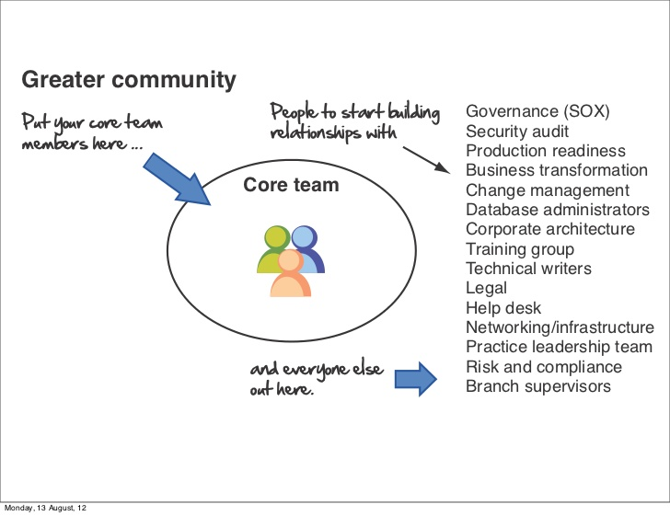
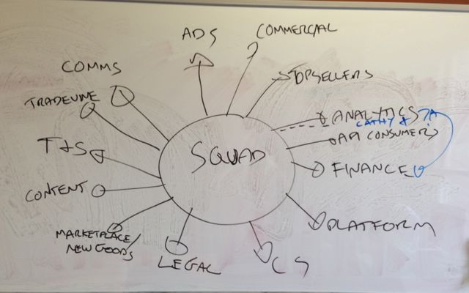
Examples - Meet your neighbours
Mamoli, S, “9 Agile steps that injected magic into our project”, https://nomad8.com/9-agile-steps-that-injected-magic-into-our-project/
Lin, D (2012), “99 Inception Deck”, https://www.slideshare.net/dleyanlin/99-inceptiondeck

Slide 20
6. Show the solution
Set expectations about deliverables
Visualize assumptions about project boundaries and scope
Communicate risk
Draw out a simple blueprint that describes the different components of your solution.

Slide 21
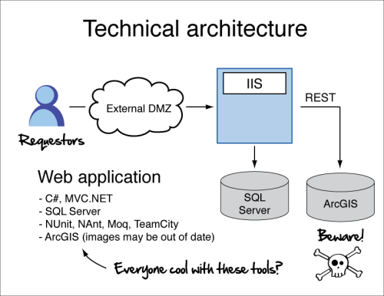
Example - Show the Solution

Slide 22
7. Ask what keeps us up at night
List down all concerns or challenges that might cause the project to fail.
By surfacing potential challenges you can identify risks early and how they might be overcome.

Slide 23
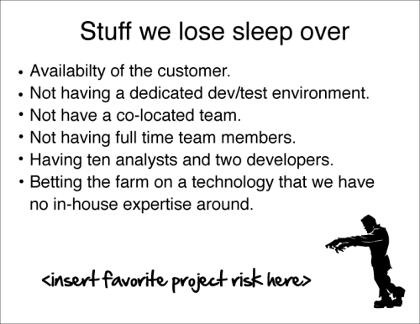
Example – Ask what keeps us up at night

Slide 24
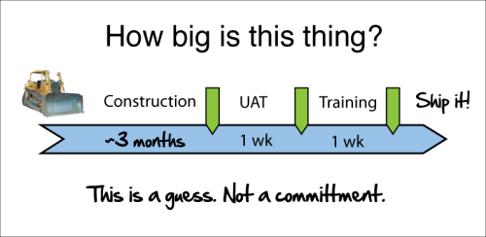
8. Size it up
How long will this take? Make a rough timeline of what you are going to do.

Slide 25
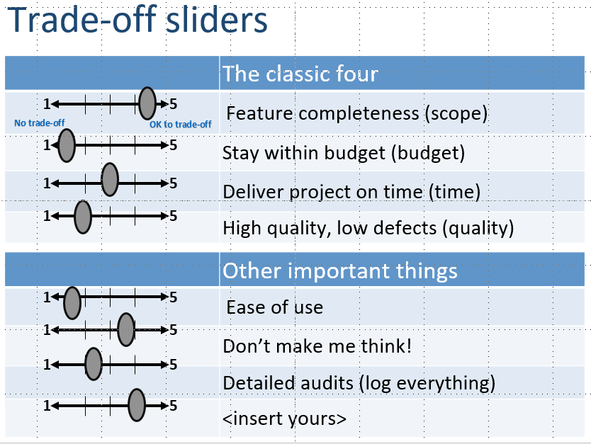
9. Be clear on what’s going to give
Tradeoffs. When push comes to shove, which will you sacrifice and which will you prioritize?
Scope
Budget
Time
Quality
People
...

Slide 26
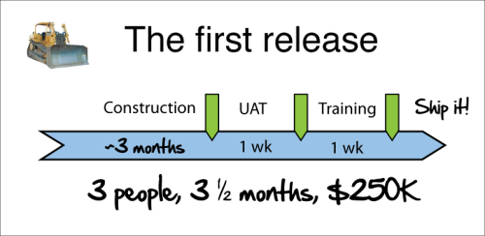
10. Show what it’s going to take
Based on your timeline...
What people do you need on your team (including roles, competencies/expectations)?
Who is your real customer
What other stakeholders are involved?
What budget do you need?

Slide 27
Difference between Points 8 and 10
Size it up
What is going to take

Slide 28
Putting it all together – download this template! https://agilewarrior.files.wordpress.com/2010/11/blank-inception-deck.pptx

Slide 29

Reading Reference
Agile Warrior (2010), “The Agile Inception Deck”, https://agilewarrior.wordpress.com/2010/11/06/the-agile-inception-deck/
Beltis, A J (2017), “15 Clever and Inspiring Restaurant Mission Statements”, https://pos.toasttab.com/blog/inspiring-restaurant-mission-statements
Chung, E, “10 Killer Nonprofit Mission Statements to Learn From”, https://www.classy.org/blog/10-killer-nonprofit-mission-statements-to-learn-from/
Egeland, B (2017), “Top 5 Toughest Questions Faced By Business Analysts On Tech Projects”, https://www.batimes.com/articles/top-5-toughest-questions-faced-by-business-analysts-on-tech-projects.html
Egeland, B (2018), “5 More Tough Questions Business Analysts Face On Tech Projects”, https://www.batimes.com/articles/5-more-tough-questions-business-analysts-face-on-tech-projects.html
Loft, “Inception Deck”, https://loft.io/guide/learning/inceptiondeck/#content
Rasmusson, J (2010), “The Agile Samurai”, pp 47-92, http://www.cs.umss.edu.bo/doc/material/mat_gral_130/the_agile_samurai.pdf

Slide 30

Summary
Learn how to create the Inception Deck
10-step Inception Deck

